Slide 1
The Efficacy of Two Different Insecticides on The Pupae Stage of Western Flower Thrips
Congxing Zhu
December 8th, 2017

Slide 2
From left to right: egg, first instar larva, second instar larva, prepupae, pupae and adult.
Western Flower Thrips Life Cycle

Slide 3
KleenGrow™
and STRIP-IT PRO™
Western Flower Thrips Damage

Slide 4
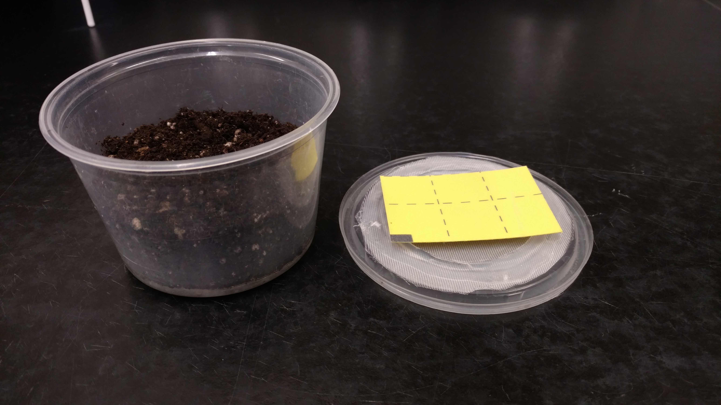
1. Blank (untreated) check.
2. Water control.
3. KleenGrow™ at 1.0 fl oz/1
gallon
4. KleenGrow™ at 0.5 fl oz/1 gallon
5. KleenGrow™ at 0.13 fl oz/1 gallon
6. KleenGrow™ at 0.06 fl oz/1 gallon
7. STRIP-IT PRO™ at 8.0 fl oz/1 gallon
8. STRIP-IT PRO™ at 5.0 fl oz/1 gallon
Experiment Materials

Slide 5
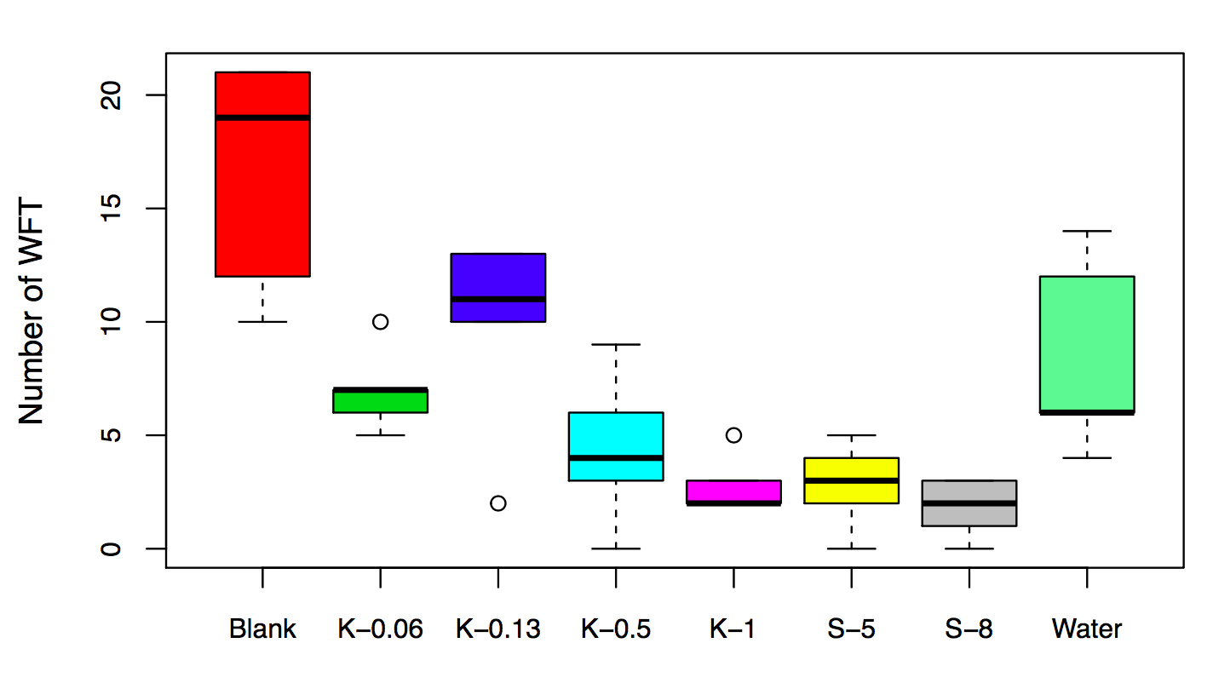

Slide 6
 | Mean | 95% CI
Blank | 16.6 | 13.6,19.6
Water | 8.4 | 4.0,10.0
K-1 | 2.8 | 6.8,12.8
K-0.5 | 4.4 | 1.4,7.4
K-0.13 | 9.8 | -0.2,5.8
K-0.06 | 7 | -0.2,5.8
S-8 | 1.8 | -1.2,4.8
S-5 | 2.8 | 5.4,11.4
Table 1. Mean and 95% CI from linear model
associated with the treatments (n=8).

Slide 7
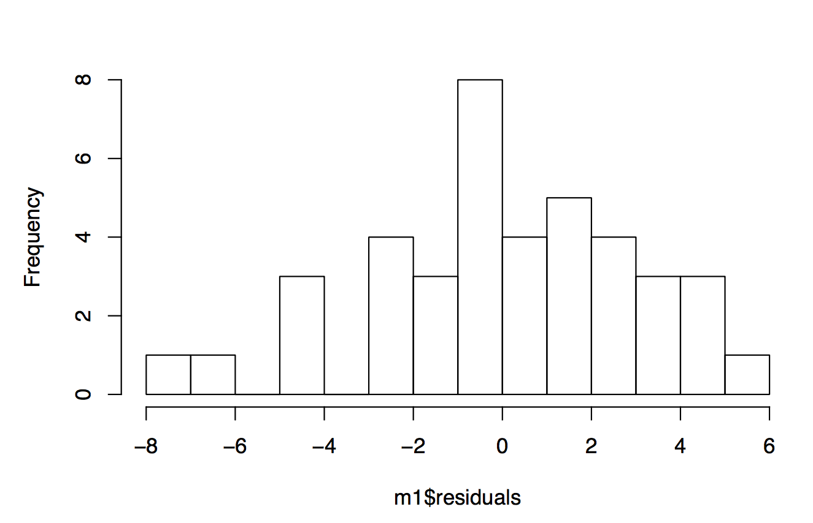
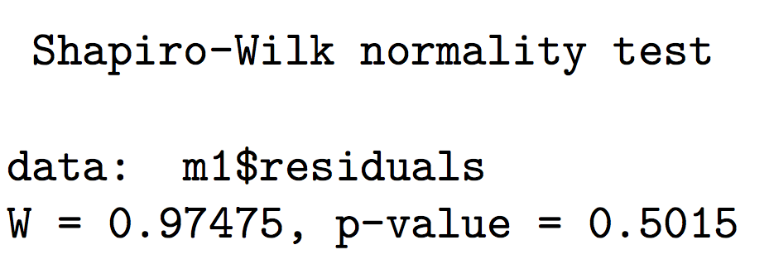
Analysis:
m1 <- lm(WFT~Tre-1,data = Data1)
Check the normality

Slide 8
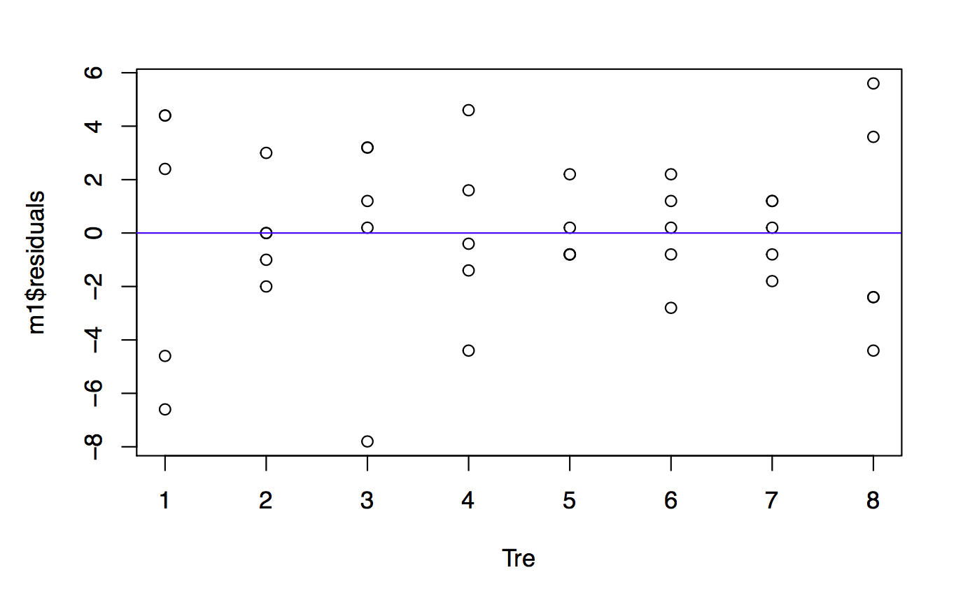
Check the constant variance

Slide 9
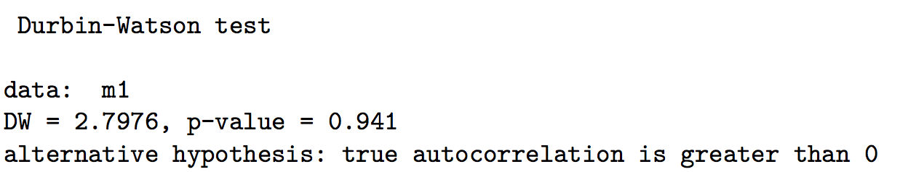
Check the independence

Slide 10
Check the outliers

Slide 11
Check the linear structure
m1 <- lm(WFT~Tre-1,data = Data1)
m2 <- glm(cbind(WFT,Num-WFT)~Tre-1,family = binomial(link = "logit"),data = Data1)
m3 <-glm(cbind(WFT,Num-WFT)~Tre-1,family = quasibinomial(link = "logit"),data = Data1)
m4 <- gamlss(cbind(WFT, Num-WFT) ~ Tre-1, data=Data1, family=BB)

Slide 12
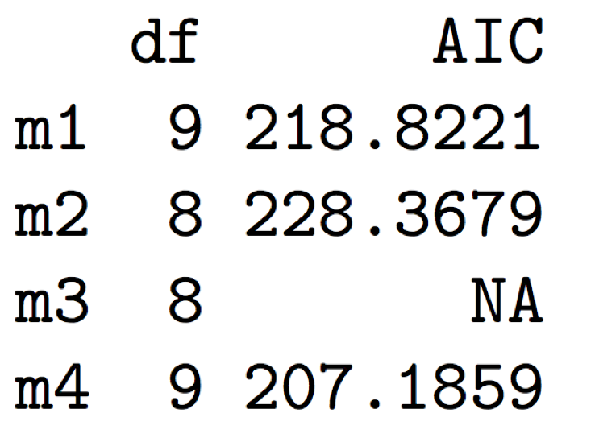
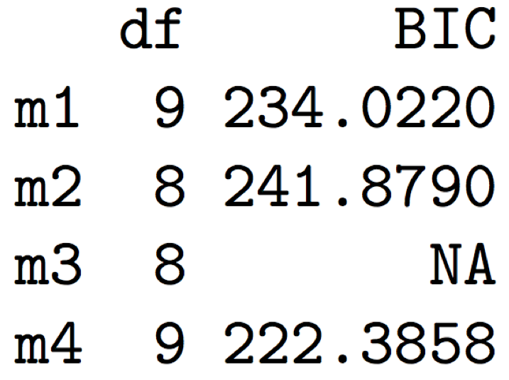
Results and Conclusion
For this project, I will still use the simple linear model to deal with the data.

Slide 13
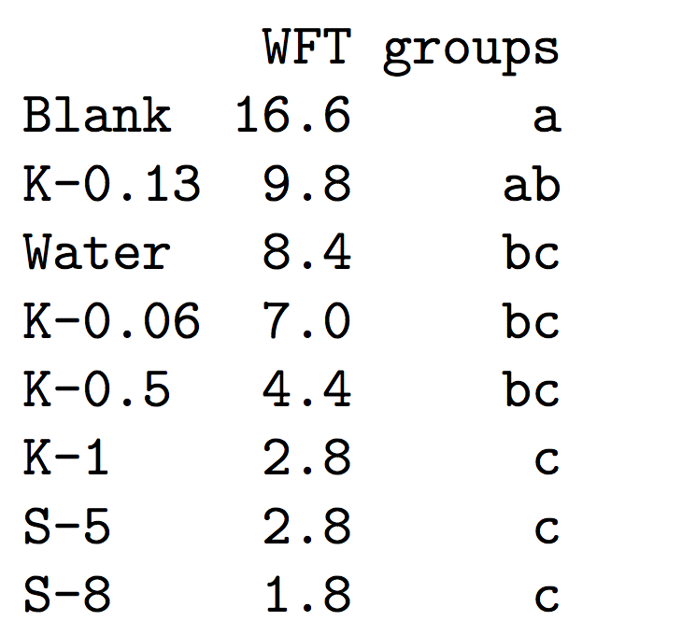
Results and Conclusion
Tukey Test Result

Slide 14
Future Work
Check all the assumptions under beta binomial model.
Remove the outlier from the data and check the model.
Compute the AIC value for quasibinomial model by hand.

